Slide 1

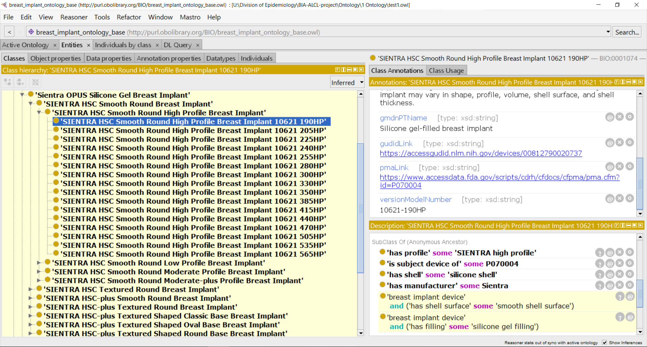
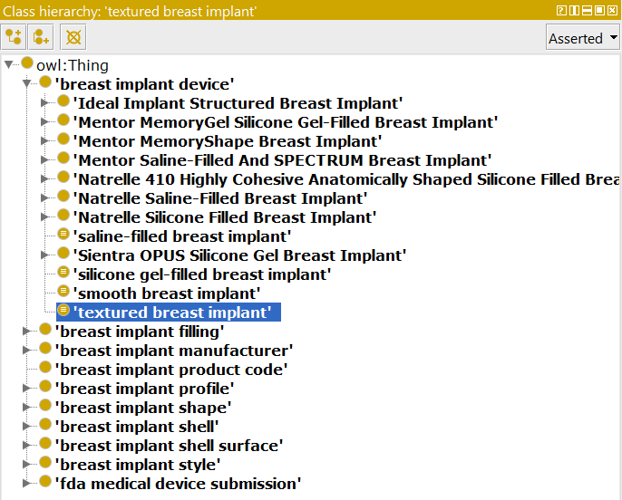
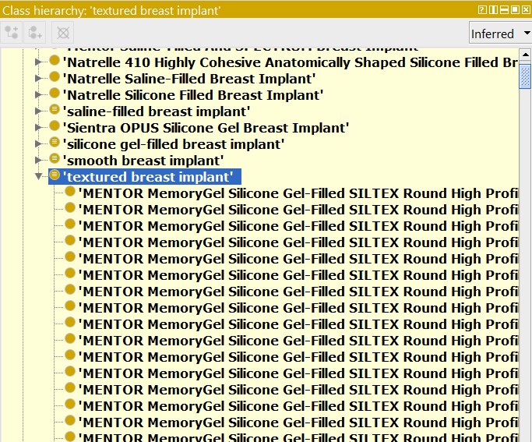
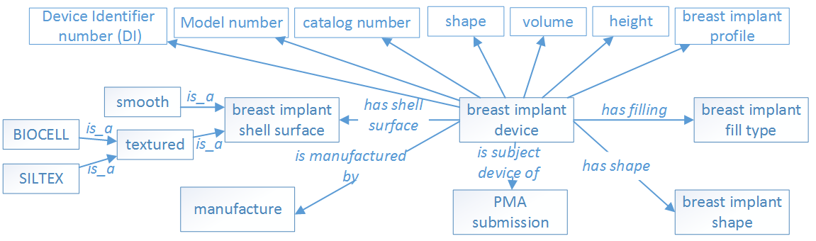
Building a Comprehensive Breast Implant Ontology Leveraging GUDID and Unstructured Data Sources
Mark Jung^{1,2}, Michael Wu^{1,3}, Asiyah Yu Lin¹, Hongying (Helen) Jiang¹, Weiguang Wang¹, Zhou Feng¹, Dongyi (Tony) Du¹, Nilsa Loyo-Berrios¹
¹FDA/CDRH/Office of Surveillance and Biometrics, Silver Spring, MD 20993
²Montgomery Blair High School, ³Wheaton High School
Background
Results
Currently, breast implant data is spread out across FDA PMAs, Global Medical Device Nomenclature, and Global Unique Identifier Database (GUDID)
This significantly hinders data analysis, such as in the BIA-ALCL project, where breast implant surface type may have a possible association with breast-implant associated anaplastic large cell lymphoma (BIA-ALCL)
A domain ontology is a formal representation of categories, properties, and relations between entities in a single domain.
A Breast Implant Ontology can categorize devices based on features; using a semantic reasoner tool, automatic classification can also occur.
An Initial ontology design pattern was created to lay out the attributes of breast implants and how they will be related to each other (Figure 1).
The Breast Implant Ontology (BIO) arranges a total of 1738 breast implant products from GUDID as lowest level terms in the hierarchical structure (individual devices).
Main class is ‘breast implant device’. All other classes point to it. Direct children consist of the 8 FDA approved breast implants each with their unique PMA number. The 2nd level is the brand names for each breast implant associated to the PMAs.
In addition to class-level features, annotations such as product code, device catalog number, version model number, GUDID link, PMA link, GMDN name, GMDN definition, and device publish dates were included in the ontology (Figure 2).
Artificially defined classes (“Saline-filled breast implant, “silicone gel-filled breast implant”, “smooth breast implant”, and “textured breast implant”) were created in the BIO to facilitate automatic classifications. For example, by defining “textured breast implant” with axioms “is a breast implant device” and “has a textured shell surface”, an automated reasoner such as ELK can automatically populate “textured breast implant” with all textured devices.
After reasoning, ELK classified 906 textured breast implants and 836 smooth breast implants from GUDID.
Objective
Create a complete ontology to classify breast implants based on their features.
Use the ontology as a backend dictionary to for a text mining tool to explore patterns/trends from BIA-ALCL cases reported in MDR or other data sources
Eventually merge with other related domain ontologies (e.g. OAE)
Help improve accuracy and scope of GUDID
Figure 2. Class Tab in Entities View in Protégé 5
Individual devices (lowest level classes) are subclasses of specific relationships (e.g. ‘has profile’ some ‘SIENTRA high profile’) and are also annotated with additional information, e.g. GUDID link and version model number.
A. Before reasoning
B. After reasoning
Methods
Data taken from Global Unique Device Identifier Database (GUDID) by querying product codes FWM and FTR and from product catalogs of sponsors (unstructured)
Product catalogs were used for cross-verification of GUDID data as well as for providing additional information, such as device dimensions
Python for relevant data extraction; Pandas and NumPy libraries for piping data through filters into a compiled Excel file.
Protégé (ontology editor) to visualize and engineer the ontology
Also used to perform reasoning to check consistency and conduct automatic classification based on logic definitions created in the ontology.
Figure 3. Before (A) and after (B) running the ELK reasoner on the Breast Implant Ontology
Defined classes, e.g. ‘saline-filled device’, ‘silicone gel-filled device’, ‘smooth device’, and ‘textured device’, need not be manually populated; instead, supplying the relevant axioms to an automated reasoner allows it to infer subclasses.
Conclusion
The current BIO is a preliminary ontology for breast implant. It includes all the GUDID breast implants, which are the products on the market. To make BIO useful for the text mining on MDR datasets, off-market historical breast implants need to be added. Future work also includes adding device dimension measurements, such as width/diameter, height, nominal fill volume, maximum fill volume, nominal projection, and max projection into the ontology. BIO will also be released as an open source to other stakeholders, e.g. researchers, industries, and organizations.
Acknowledgements
Disclaimer
Authors want to acknowledge the valuable support from OSB and DSD teams, particularly Danica Marinac-Dabic, Binita S Ashar, Karen Nast, Sung Yoon, Trisha Eustaquio, and Tajanay Ki.
The views expressed are the authors’ and not necessarily those of the Food and Drug Administration, or the Department of Health and Human Services.
Figure 1. Initial ontology design pattern
www.fda.gov

